Slide 1
Requirement Engineering
18AIC204T- Software Engineering Principles

Slide 2
Team Members
Tharun-(RA2011047010086)
Rahi jain-(RA2011047010082)
sandeep-(RA2011047010154)
Charith varma-(RA2011047010128)
Ajay-(RA2011047010114)

Slide 3
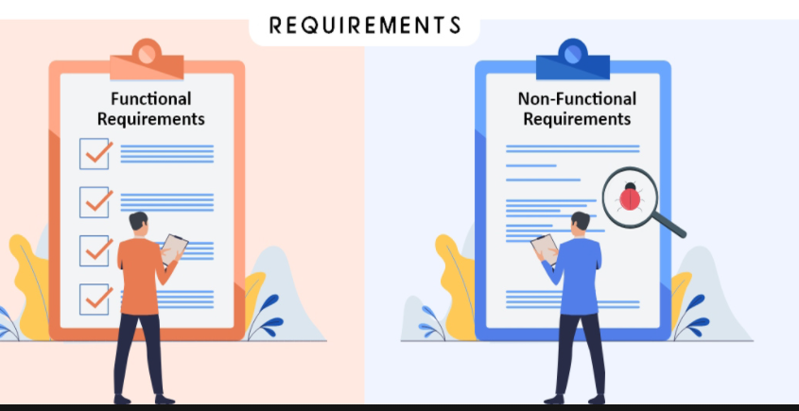
Types of Requirements
FUNCTIONAL REQUIREMENTS.
(what the system do)
NON- FUNCTIONAL REQUIREMENTS.
(how the system do it)

Slide 4
Functional requirements
A Functional Requirement (FR) is a description of the service that the software must offer. It describes a software system or its component. A function is nothing but inputs to the software system, its behavior, and outputs. It can be a calculation, data manipulation, business process, user interaction, or any other specific functionality which defines what function a system is likely to perform. Functional Requirements in Software Engineering are also called Functional Specification.

Slide 5
Differences between Functional and Non functional
Requirements are compulsory.
End result is product feature.
Easy to Capture.
Focuses on user requirement.
Captured in use case.
describes what the product does.
Requirements are not compulsory.
End result is product properties.
Hard to Capture.
Focuses on user’s expectation and experience.
Describes how the product works.

Slide 6
FUNCTIONAL REQUIREMENTS
The following subsections illustrate functional requirements to be fulfilled by the proposed system:
LOGIN vote
VERIFICATION PROOF vote confirmation message
APPOINTMENT LOGOUT

Slide 7
Non functional requirements
● Security: The consumer can only use this website by using a unique id and password, thus making security to our website and network server.
● Performance: The customer can enter quickly, easy without any effort as an organized way and our website will be more reliable.
● Usability: Every consumer can use this website easily.
Reliability: The system has to be very reliable due to the importance of data and the damages incorrect or incomplete data can do.

Slide 8
System requirements contd..
1.Hardware requirements
A processor of pentinum 4 , 1.2Ghz or faster.
4 GB of RAM(8GB oF RAM recommended).
A high-speed Internet connection(1.5 Mbps upload and download
Required;5 Mbps or better required)

Slide 9
System requirements contd..
2.Software requirements
Operating system
Microsoft Windows 7 or newer,Apple macos 10.14 or newer
Web browser
Google chrome,the latest version,is recommended
Antivirus software ,updated regularly, is strong recommended.

Slide 10
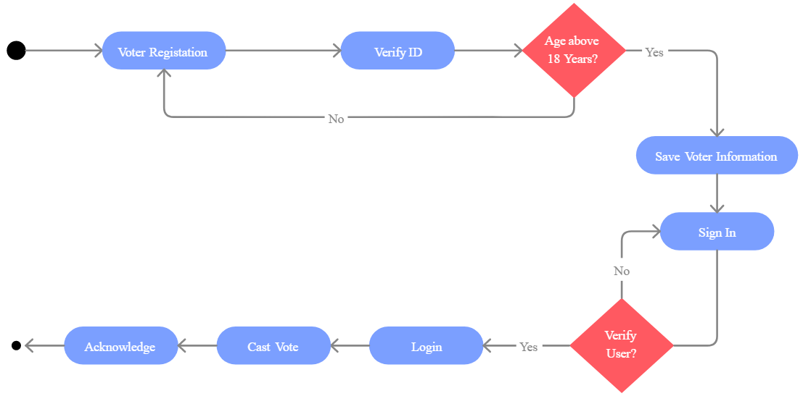
Activity Diagram
Online Voting System

Slide 11
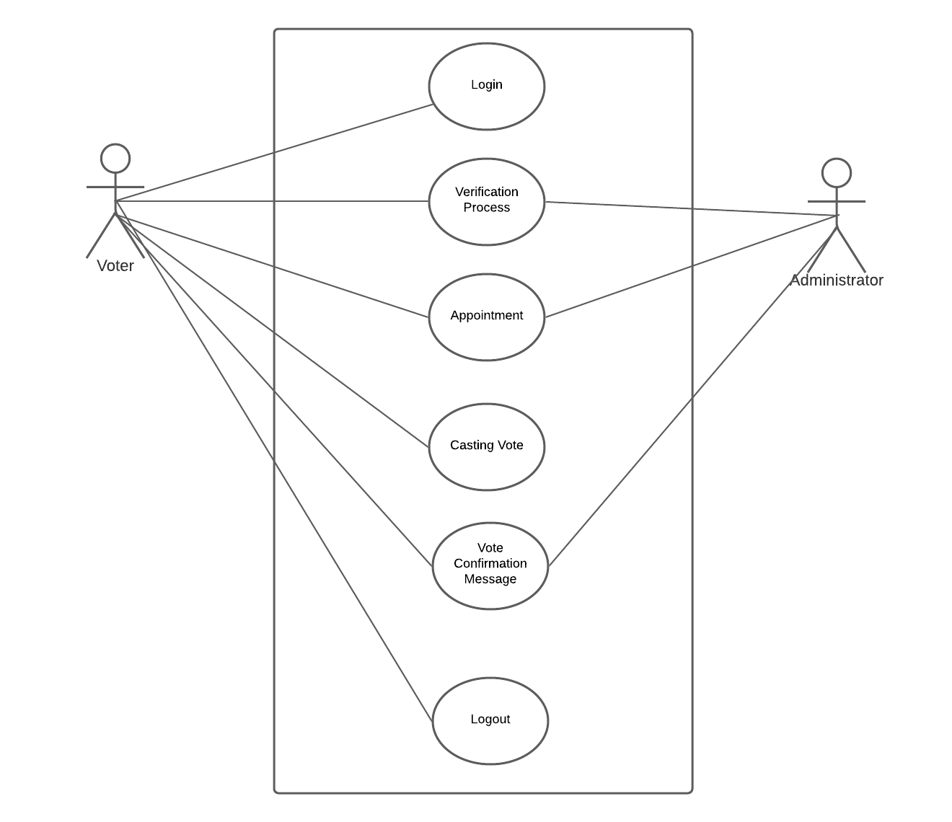
Use Case Diagram

Slide 12
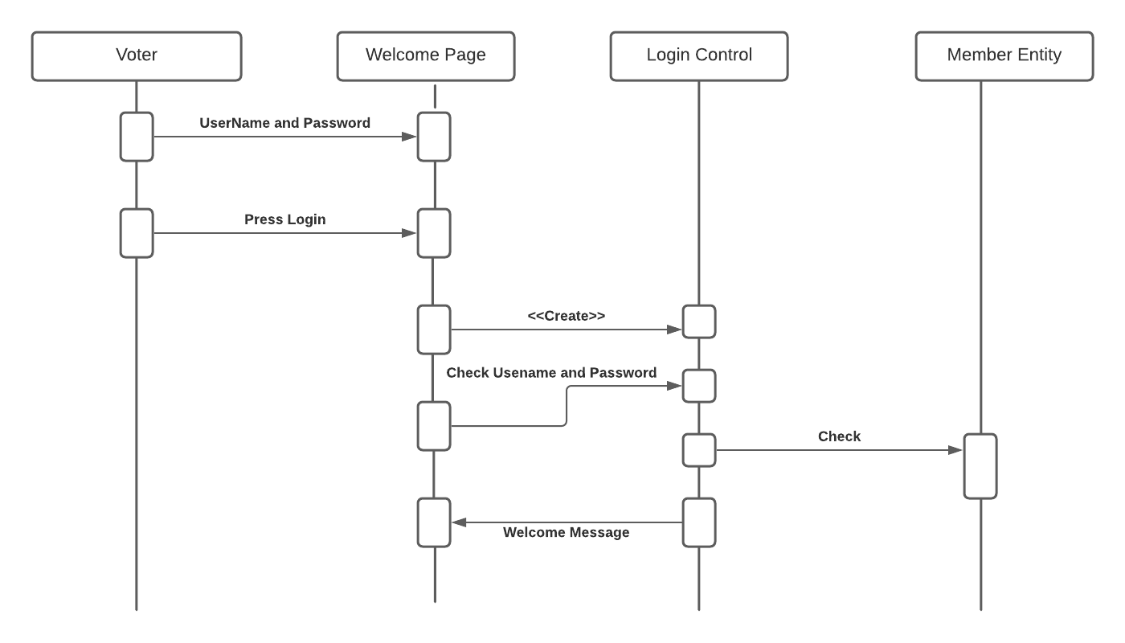
Sequence Diagram

Slide 13
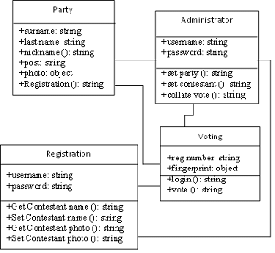
Class Diagram

Slide 14
THANK YOU

